Slide 1
E-book app
C#
Nguyen Xuan Huy

Slide 2
CONTENTS
Introduction
Methods
Demo

Slide 3
01
Introduction

Slide 4
IT frameworks
Using C# programming language (Winform)
MVC design pattern
Microsoft sql server
EntityFramework

Slide 5
02
Methods

Slide 6
GUI
Login
Signup
Admin Form
User From
User login
Sign up account
Data management
Listen to e-book, read book, search book

Slide 7
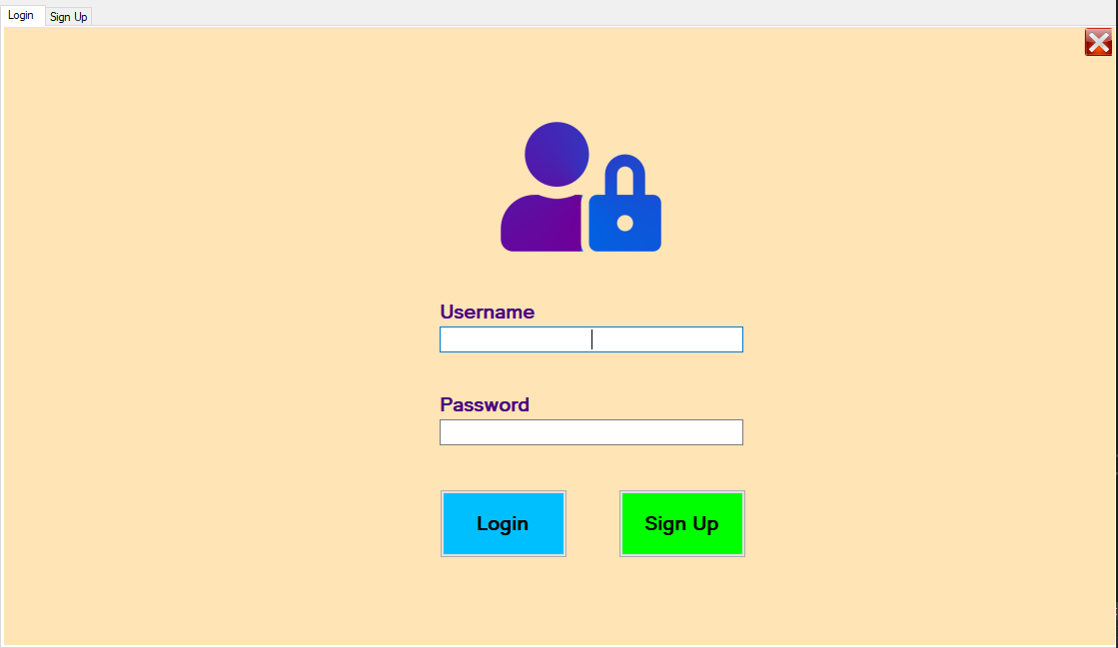
Login form

Slide 8
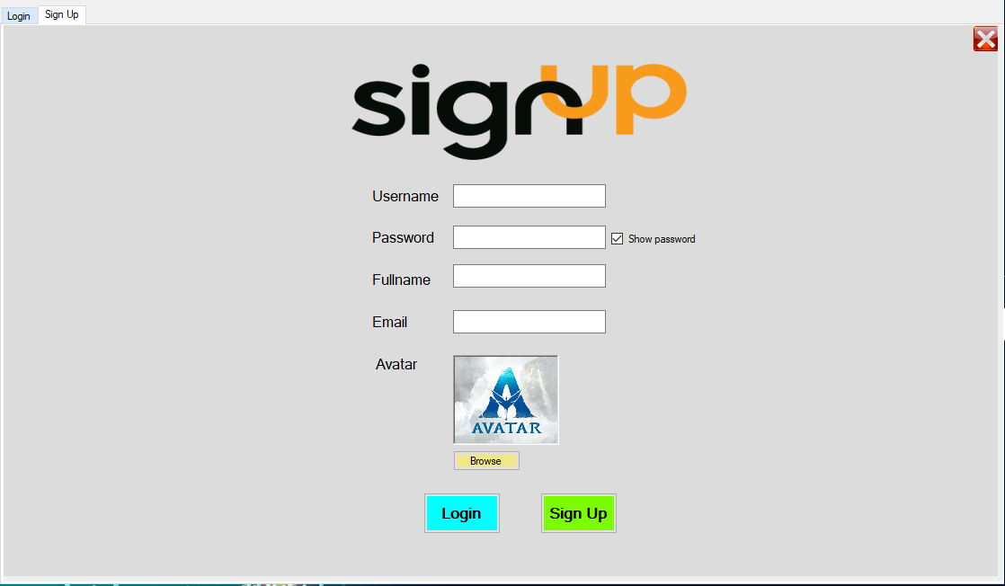
Sign up form

Slide 9
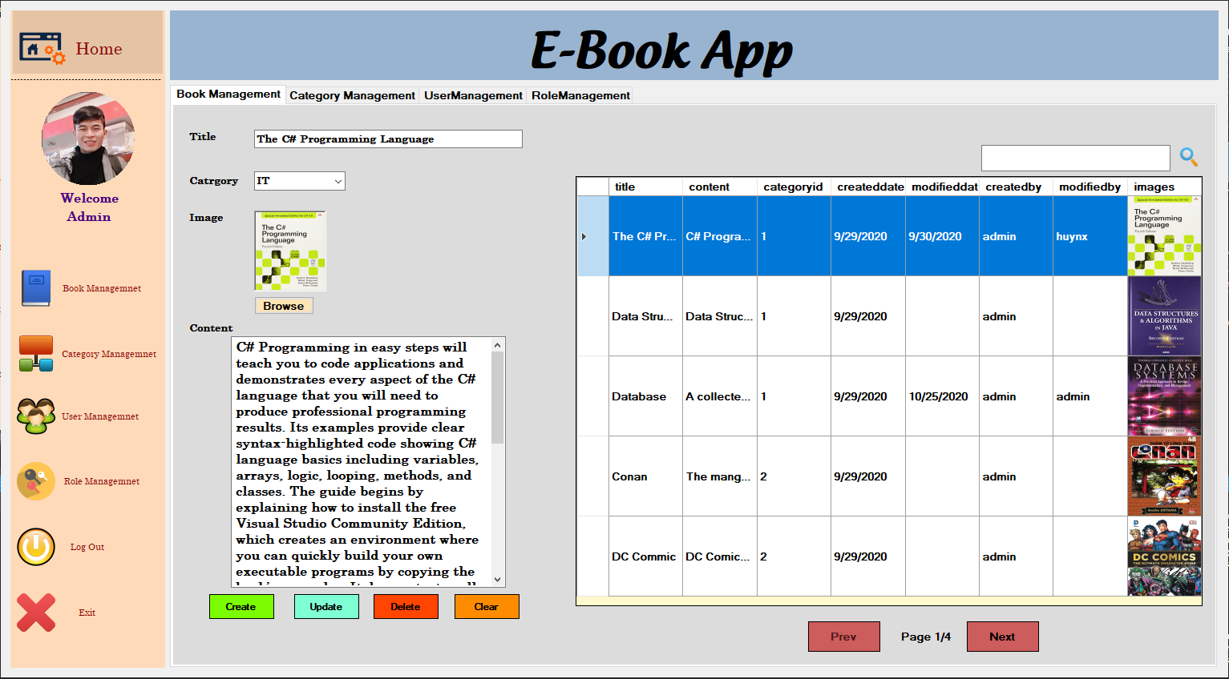
Admin form

Slide 10
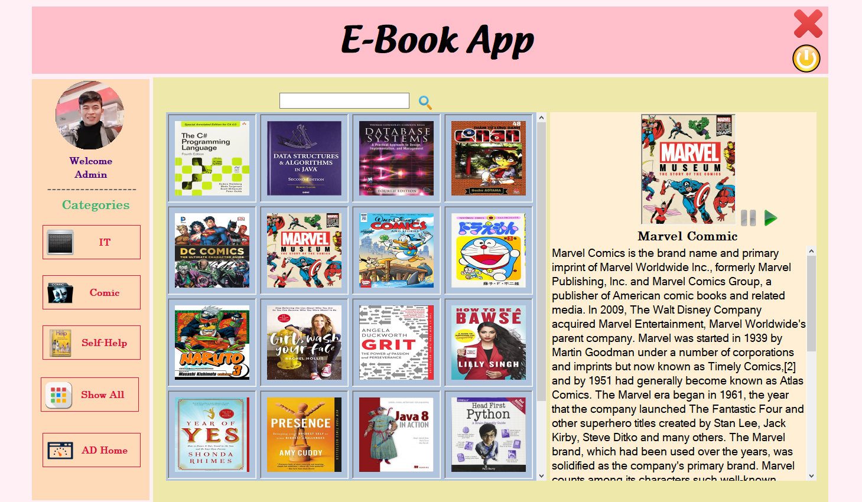
User form

Slide 11
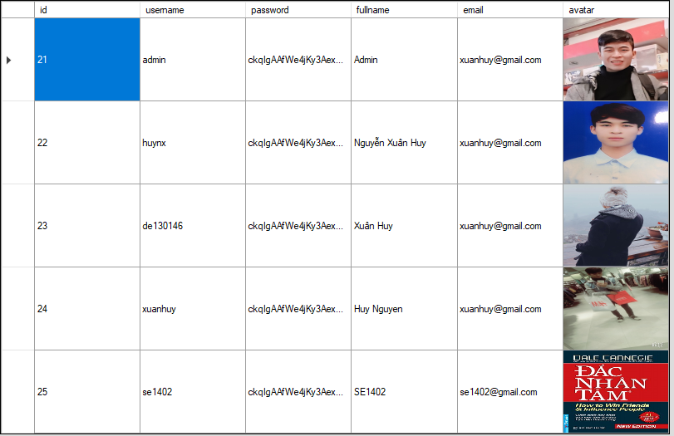
Security
Password Encryption using MD5

Slide 12
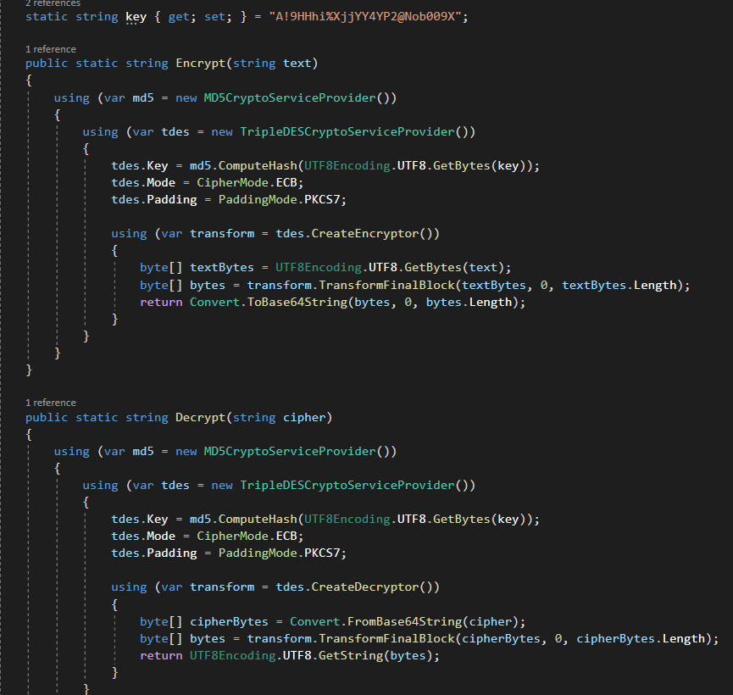

Slide 13
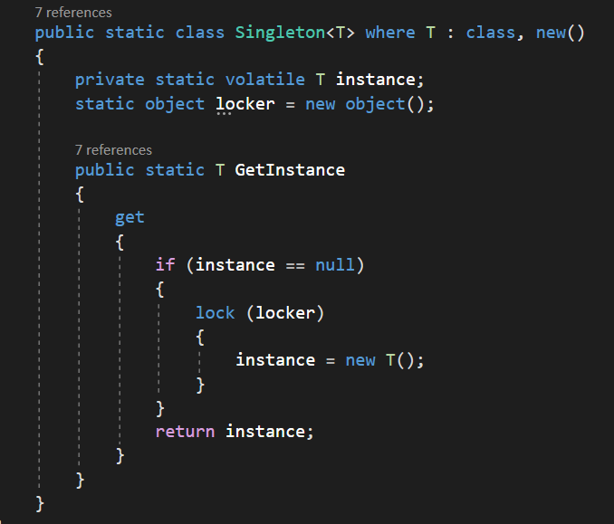
Singleton

Slide 14
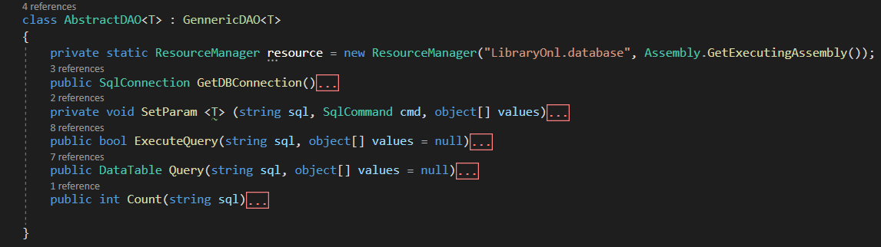
Core database

Slide 15
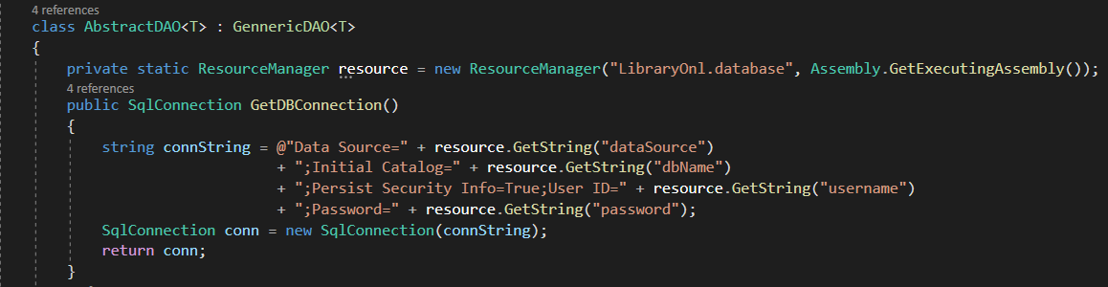
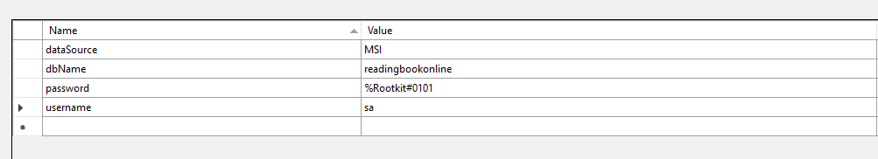

Slide 16
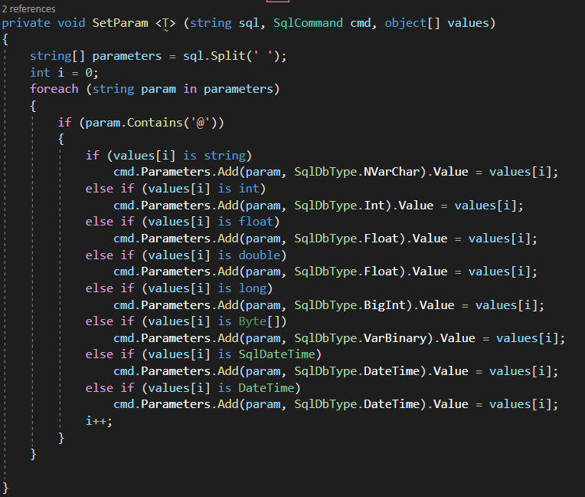

Slide 17
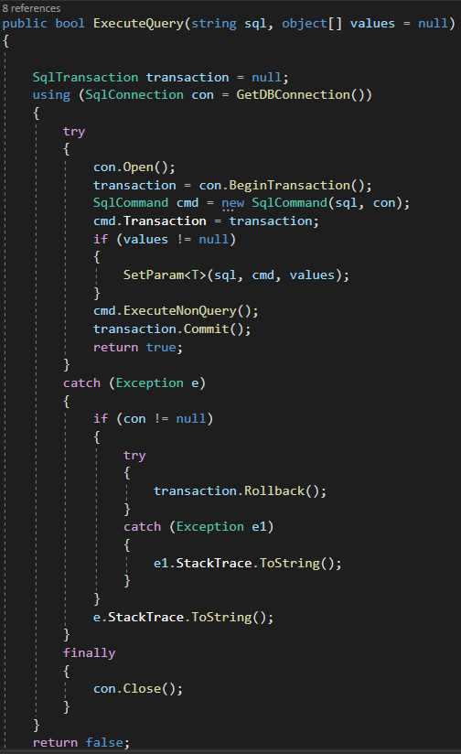
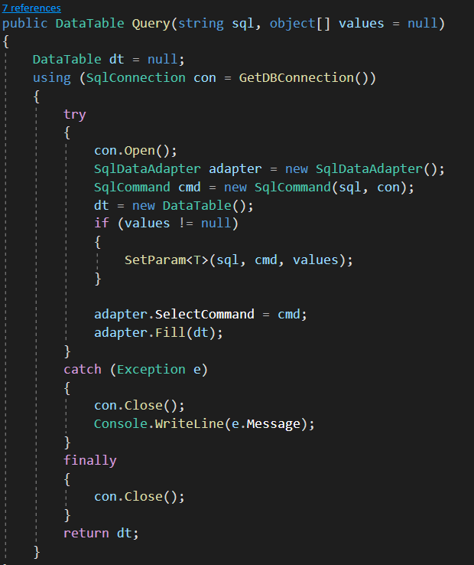

Slide 18
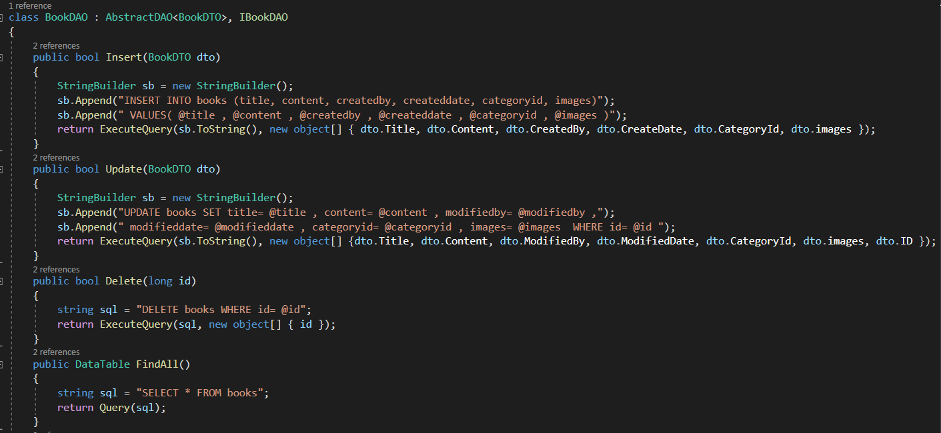

Slide 19
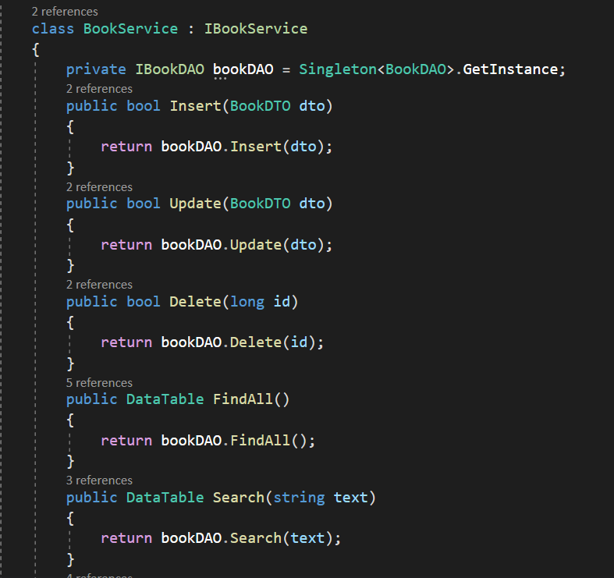

Slide 20
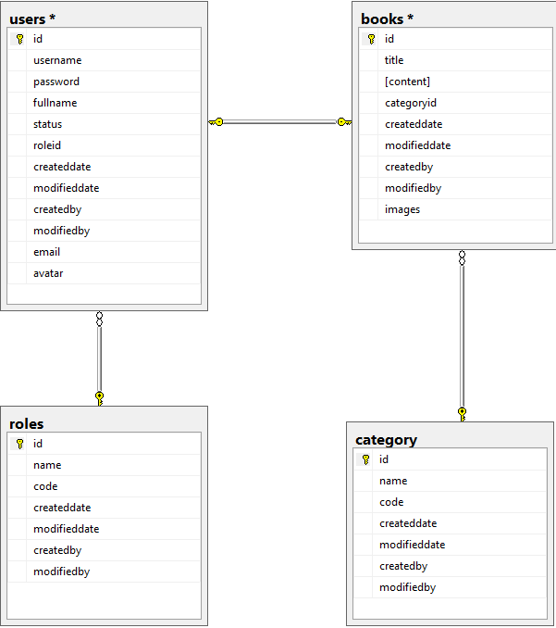
Database diagram

Slide 21
03
Demo

Slide 22

Thanks for your attention!
C#
SE1402

